Slide 1
Notes:
1 sec
Agenda:
First part NS
Second part NS+A
http://angularjs.blogspot.nl/2015/12/building-mobile-apps-with-angular-2-and.html

Slide 2

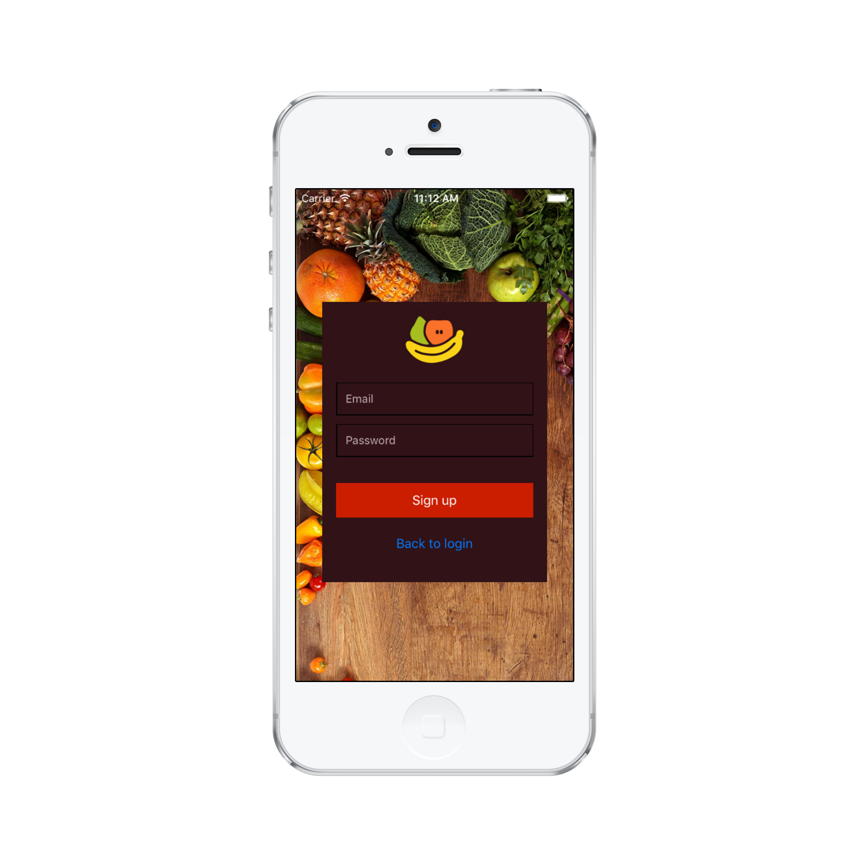
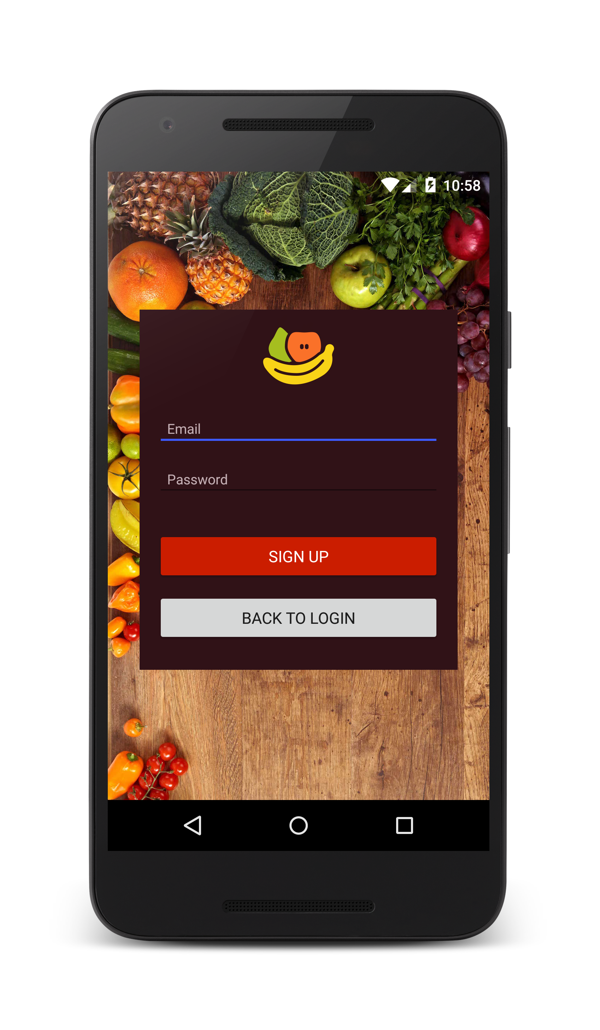
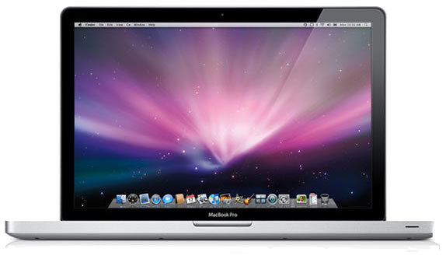
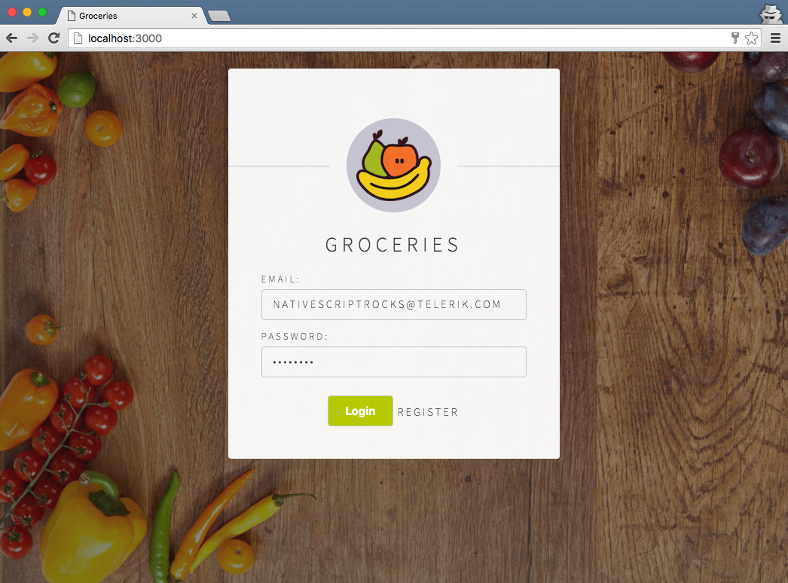
Android
iOS
Web

Slide 3



Choice
Notes:
1.27

Slide 4


Agenda
Slide show NativeScript
Install Playground App + Preview App
Prerequisites NativeScript (node.js and NativeScript CLI)
Create app via CLI
NativeScript Playground
Example [Demo]
Marketplace
Tutorial NativeScript Playground
Prerequisites NativeScript Sidekick [Demo]
Install NativeScript Sidekick
Open project in NativeScript Sidekick
Run emulator / simulator
Cloud build
Connect master-details app to Firebase [Demo]

Slide 5
Setup alternatives NativeScript
Quick setup
Full Setup
Install NativeScript Sidekick

Slide 6
Quick Setup Limitations
The NativeScript CLI quick setup allows you to test your applications on a Preview app that runs on your iOS or Android device(s).
Limitations:
Plugins
The Preview app comes with a predefined set of NativeScript plugins.
Resources
The Preview app comes with predefined set of resources, such as app icons, splash screens, and image files.
Debugging
The Preview app does not allow you to use many of NativeScript’s debugging tools, such as Chrome DevTools.
Unit Tests
The Preview app does not allow you to run use NativeScript’s unit testing workflows.
Lazy Loading
The Preview app cannot run NativeScript apps that use Angular’s lazy loading technique for loading modules.
Notes:
The NativeScript CLI quick setup allows you to test your applications on a Preview app that runs on your iOS or Android device(s).
Although this is great for getting started, there are some limitations to using the Preview app. If you hit any of the scenarios below, you need to complete the NativeScript CLI full setup to build and run your apps.
Plugins
The Preview app comes with a predefined set of NativeScript plugins. If your app needs to utilize a plugin that is not present in the Preview app, you will see a warning message and your app might not work as expected.
Resources
The Preview app comes with predefined set of resources, such as app icons, splash screens, and image files. If you need to work with additional files in your application’s App_Resources folder, you need to switch to the full setup workflow.
Debugging
The Preview app does not allow you to use many of NativeScript’s debugging tools, such as NativeScript’s integration with the Chrome DevTools.
Unit Tests
The Preview app does not allow you to run use NativeScript’s unit testing workflows.
Lazy Loading
The Preview app cannot run NativeScript apps that use Angular’s lazy loading technique for loading modules.

Slide 7
Full Setup
Full setup when you want to build localy
Advanced setup Windows: https://docs.nativescript.org/start/ns-setup-win
Advanced setup macOS: https://docs.nativescript.org/start/ns-setup-os-x
Advanced setup Linux: https://docs.nativescript.org/start/ns-setup-linux
Notes:
With the full setup, the NativeScript CLI builds truly native iOS and Android apps locally.

Slide 8
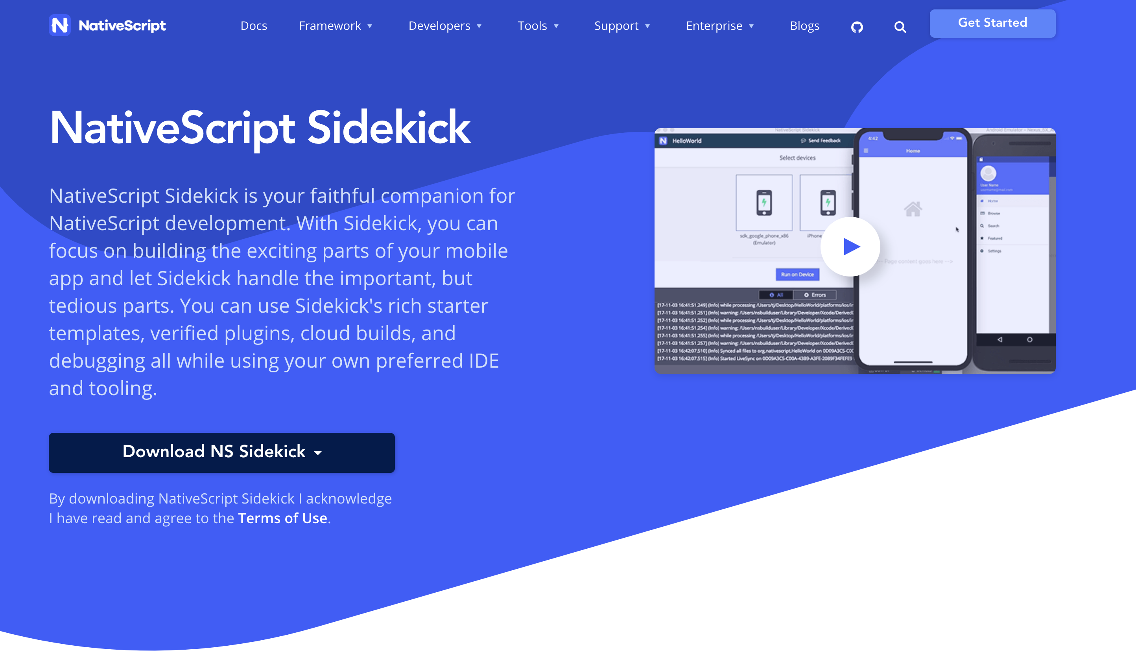
Setup NativeScript Sidekick [Demo]
Notes:
Develop and build app in the cloud.
You do not need installation of Android or Xcode locally.
You can even build iOS apps on a Windows machine → because we build in the cloud
https://www.nativescript.org/nativescript-sidekick

Slide 9
Quick setup
Install node.js (https://nodejs.org/) (check by node –version)
[sudo] npm install -g nativescript (check by running tns)
Install NativeScript Playground app
Install NativeScript Preview app
Notes:
https://docs.nativescript.org/start/quick-setup

Slide 10
Getting started
Create an account at Telerik
tns login

Slide 11
Let’s create a NativeScript app!
Open a terminal / cmd
tns create
Answer the following questions:
First, what will be the name of your app? firstApp
Next, which style of NativeScript project would you like to use: Angular
Finally, which template would you like to start from: Hello World
Notes:
https://docs.nativescript.org/start/cli-basics

Slide 12
Let’s create a NativeScript app!
cd firstApp
tns preview
Use NativeScript Playground app and scan the QR code

Slide 13
Open your project in your IDE
Install Visual Studio (https://visualstudio.microsoft.com/)
Browse en open your firstApp

Slide 14
Try Livesync
Let’s add a simple image to your app so you can see how livesync works.
See tutorial: https://docs.nativescript.org/start/cli-basics
Notes:
https://docs.nativescript.org/start/cli-basics

Slide 15
NativeScript Playground

Slide 16
https://play.nativescript.org/

Slide 17
NativeScript Playground
NativeScript Playground is a browser-based environment for developing simple NativeScript apps.
It’s a great place to get started.
As you can develop apps without needing to install the various SDKs and tools needed for native iOS and Android.
All you need is an iOS or Android device.
Notes:
The NativeScript Playground is a place in the cloud where you can just play around with NativeScript and Vue.js from your browser until you figure out the basics.

Slide 18
NativeScript Playground [Demo]

Slide 19
NativeScript Playground [Demo]

Slide 20
Marketplace
https://market.nativescript.org/
Tab: Plugins
Tab: Templates
Tab: Samples (Playground)

Slide 21
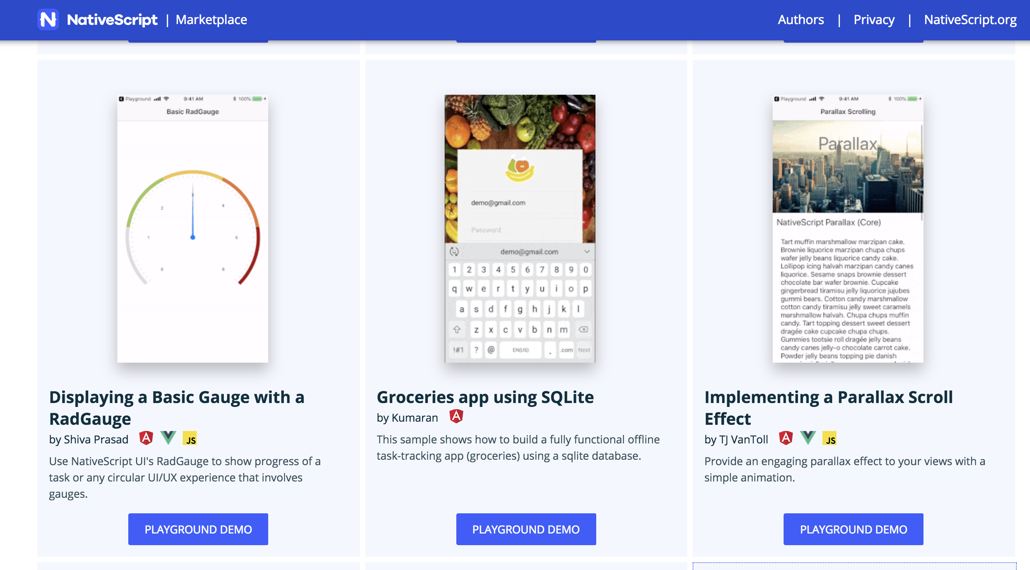

Slide 22
NativeScript Playground Tutorials
NativeScript with JavaScript
NativeScript with Angular
NativeScript with Vue.js

Slide 23
Login NativeScript Playground
Go to: https://play.nativescript.org/
Login with your Telerik account

Slide 24
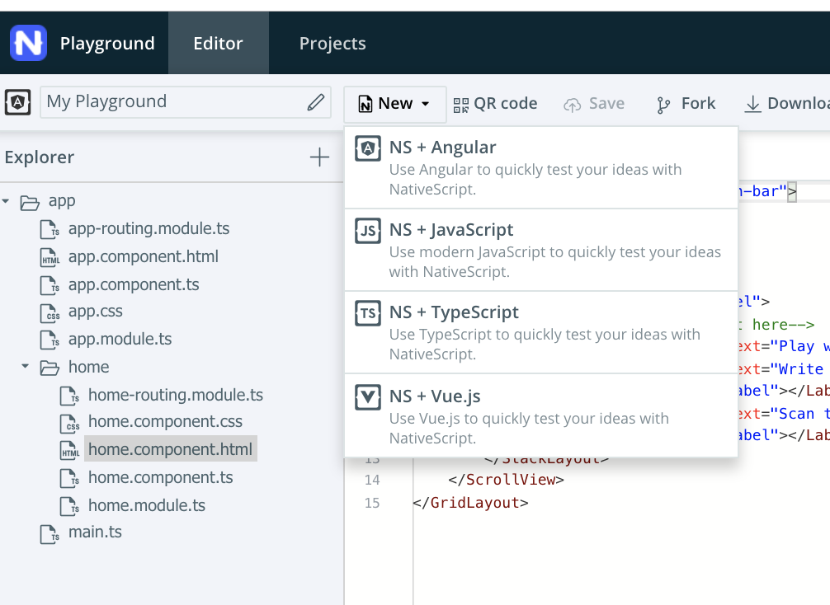
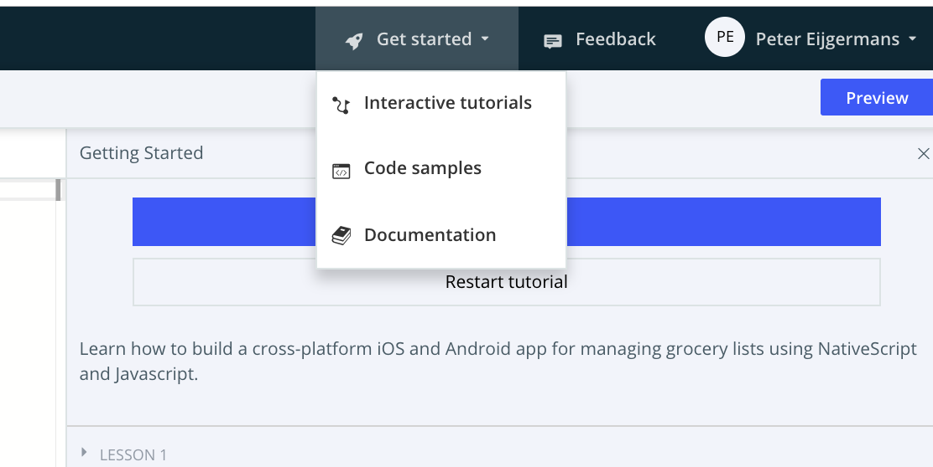
Tutorial NativeScript with JavaScript
Choose NS + JavaScript
Choose

Slide 25
Tutorial NativeScript with Angular
Choose NS + Angular
Choose

Slide 26

Tutorial NativeScript with Vue.js
Choose NS + Vue.js
Choose
Notes:
Alternatieve tutorial: https://nativescript-vue.org/en/docs/getting-started/playground-tutorial/

Slide 27
How to go live…
Download sample from {N} Playground
full setup
tns run ios --emulator
tns run android --emulator

Slide 28
NativeScript Sidekick [Demo]

Slide 29
Add Firebase to your App
https://github.com/NativeScript/template-master-detail-ng/blob/master/tools/firebase/firebase-database-setup.md
https://github.com/EddyVerbruggen/nativescript-plugin-firebase
https://www.youtube.com/watch?v=IextEpoIzwE&feature=youtu.be
Import data: https://www.youtube.com/watch?v=w6S9_xJLR50

Slide 30
Steps to configure Firebase

Slide 31
https://github.com/petereijgermans11/workshop-nativescript-firebase

Slide 32

Steps to configure Firebase
Create your free Firebase account
create emulator
tns create or use {NS} Sidekick → select template !
Add a new Firebase Project
Project Overview → Select icon iOS or Android
Add project in Firebase → bundle id = nativescript.id from package.json → next: register App
(tns plugin add nativescript-plugin-firebase)
Download the generated Firebase configuration files and replace them in the existing {NS}-project
Get the Project id from the Firebase-project settings and place it in config.ts
Import Sample JSON data in Firebase Database
Set Default database security rules in Firebase
Set Default storage security rules in Firebase
(For this example: Do not use authentication in Firebase. Also not Anonymous authentication.)
Comment out the readonly section in this car detail edit component !

Slide 33
0 Create accounts
Create Firebase account + login
Create tns account + login

Slide 34
1 Create emulator
tns run ios --emulator
tns run android --emulator

Slide 35
2 NativeScript Sidekick

Slide 36
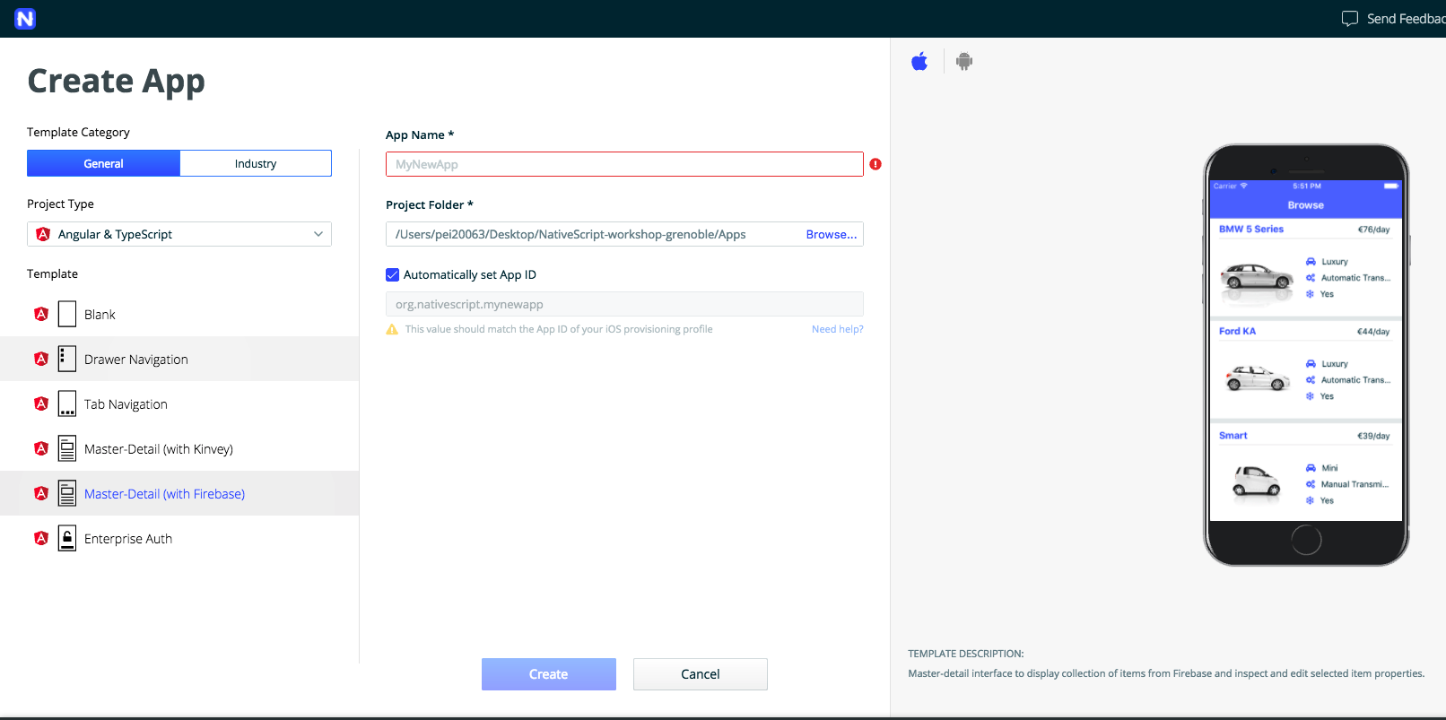
Select project in {N} Sidekick

Slide 37
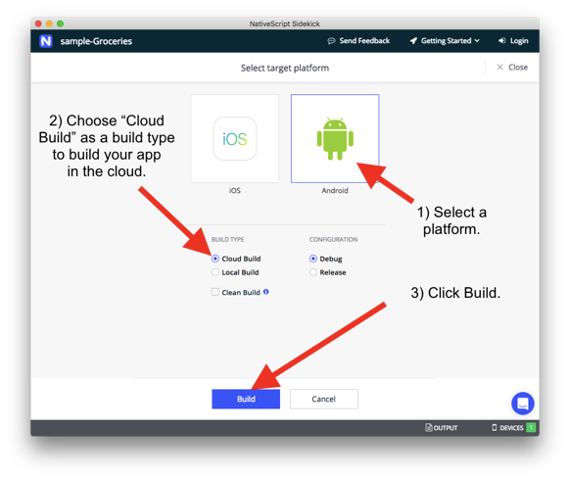

Slide 38
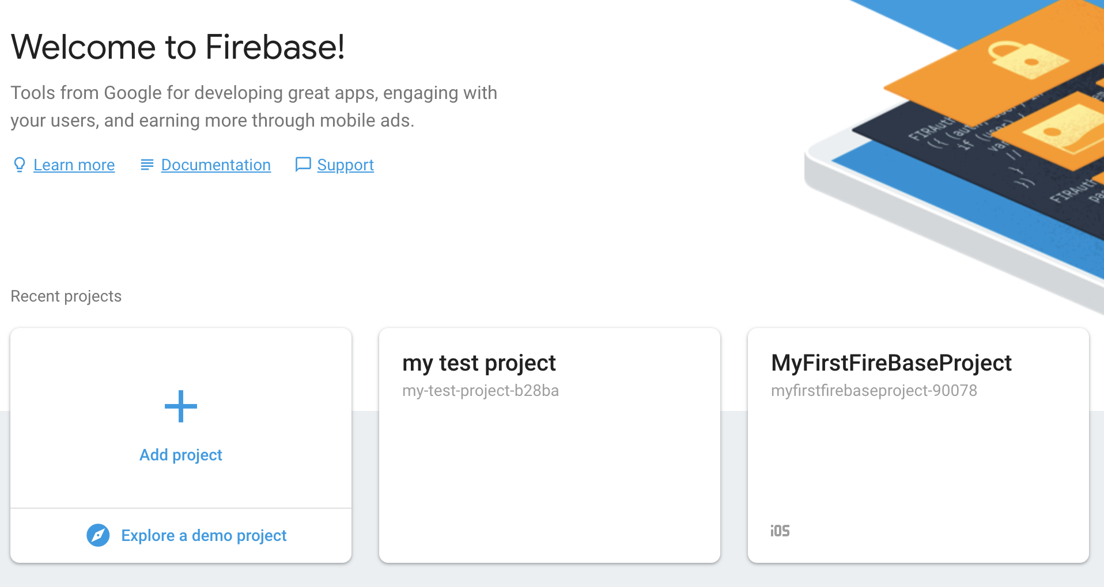
3 Add new Firebase Project

Slide 39
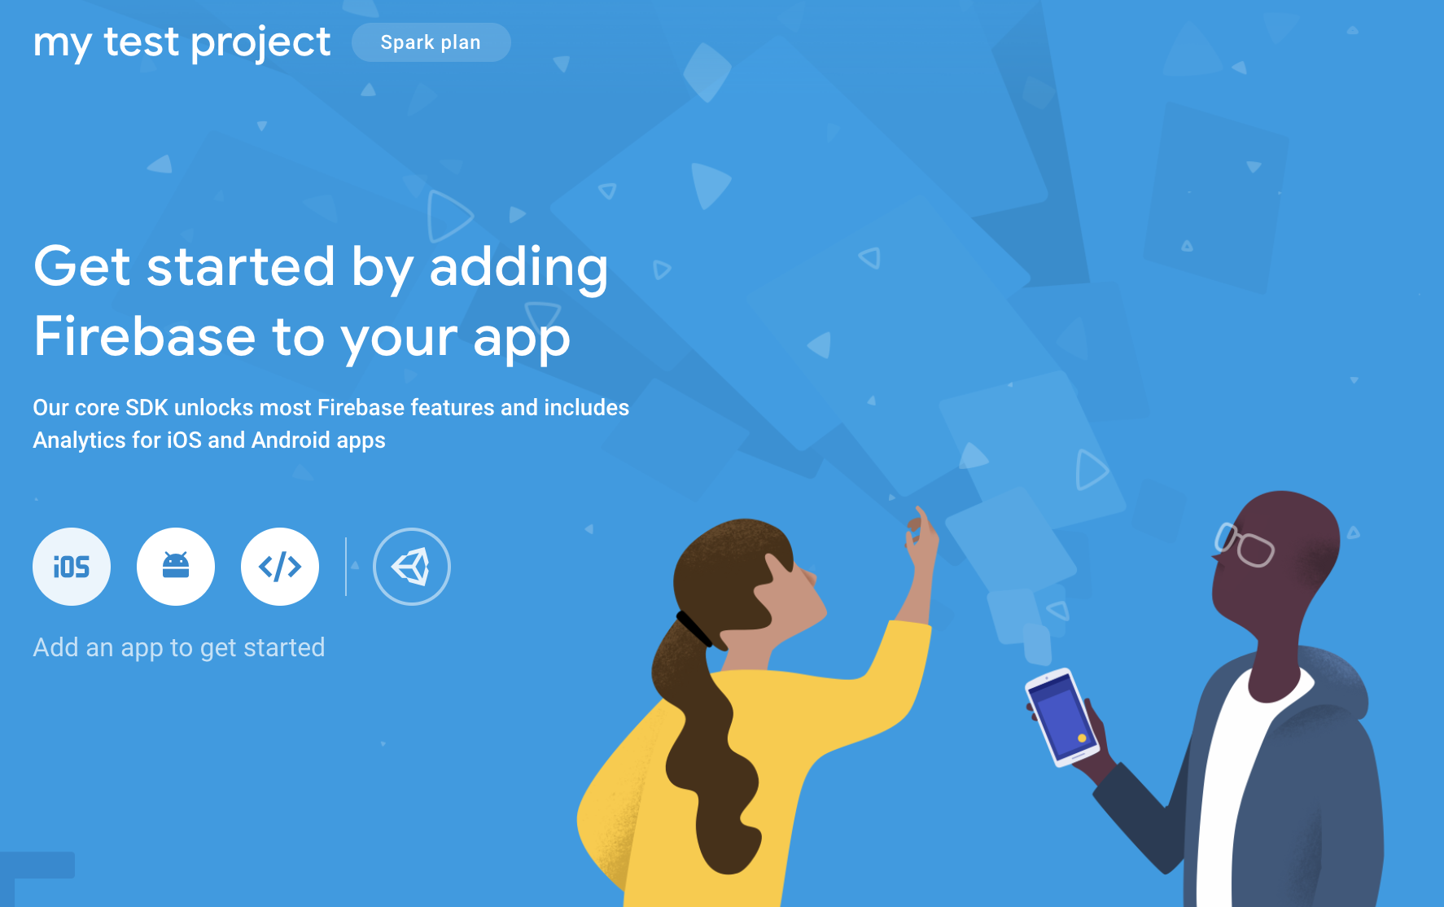
4 Select iOS or Android icon

Slide 40
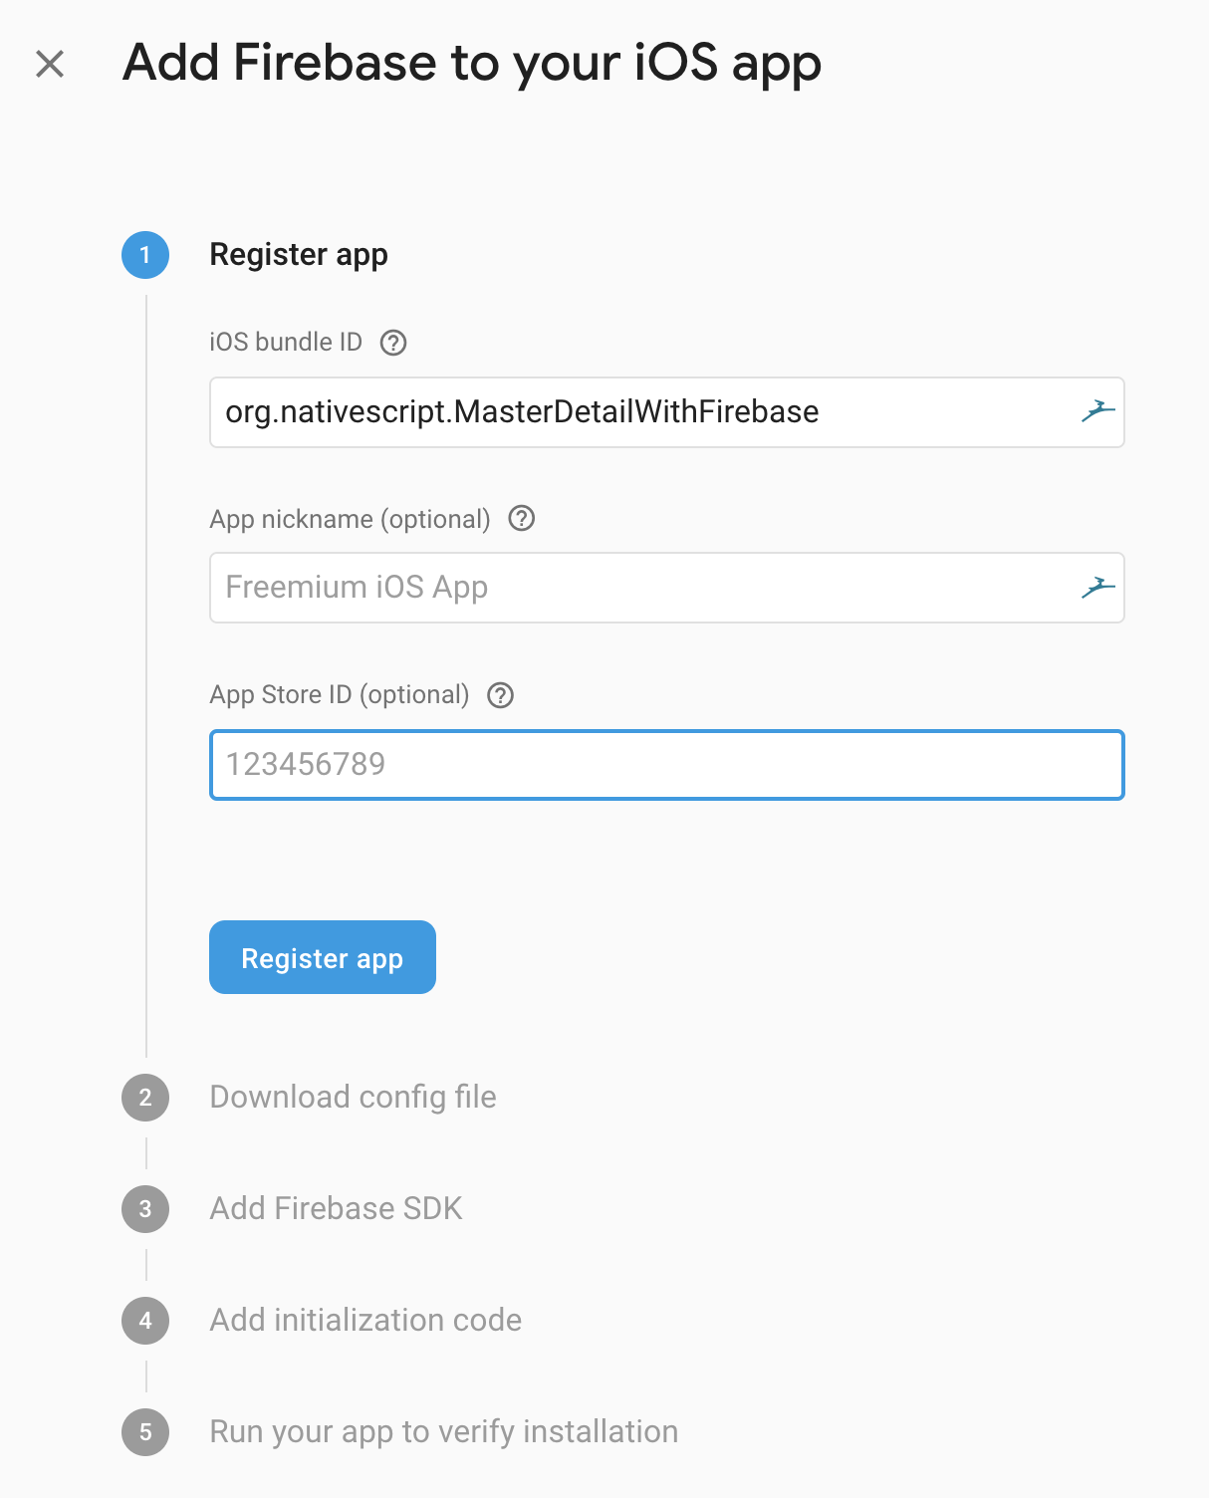
5 Register App
Notes:
bundle id = nativescript.id from package.json

Slide 41
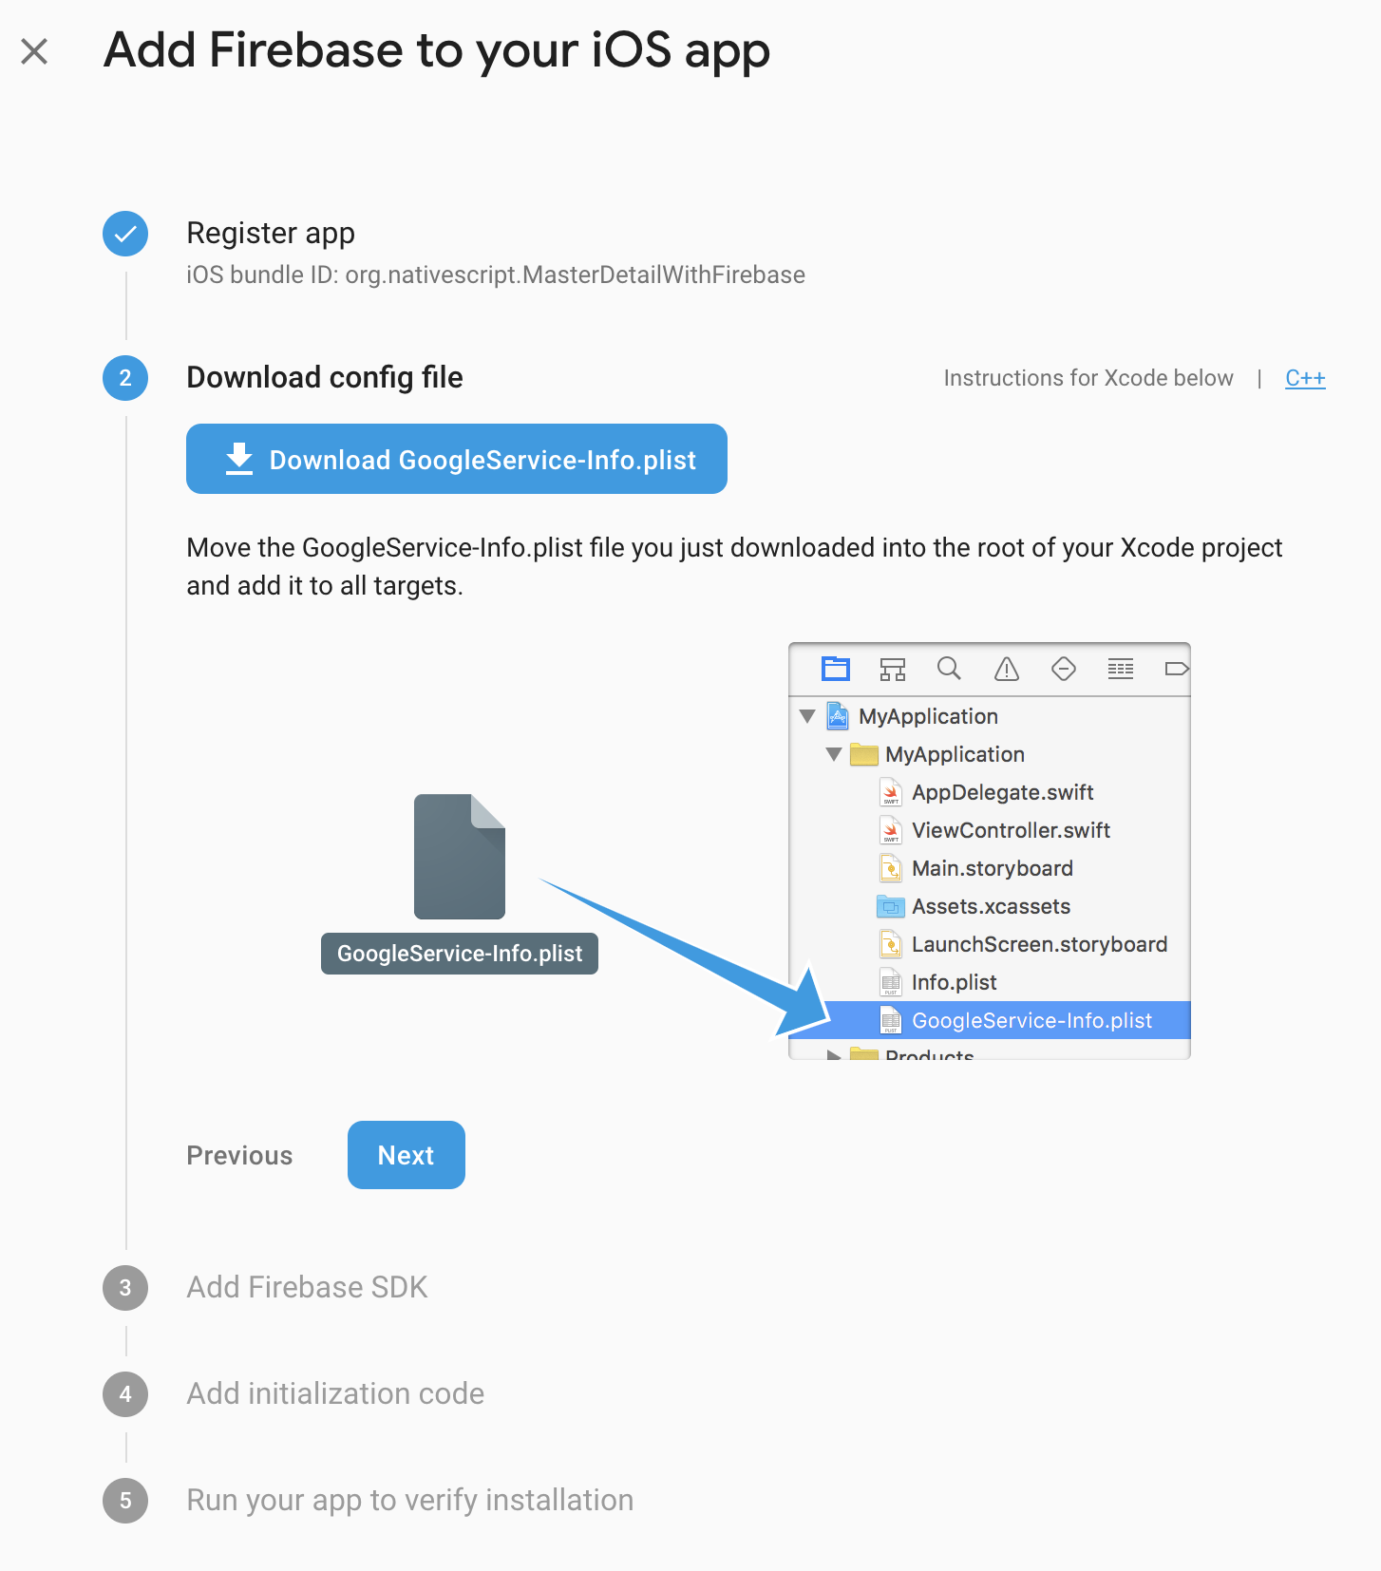
6 Download the generated Firebase configuration files

Slide 42
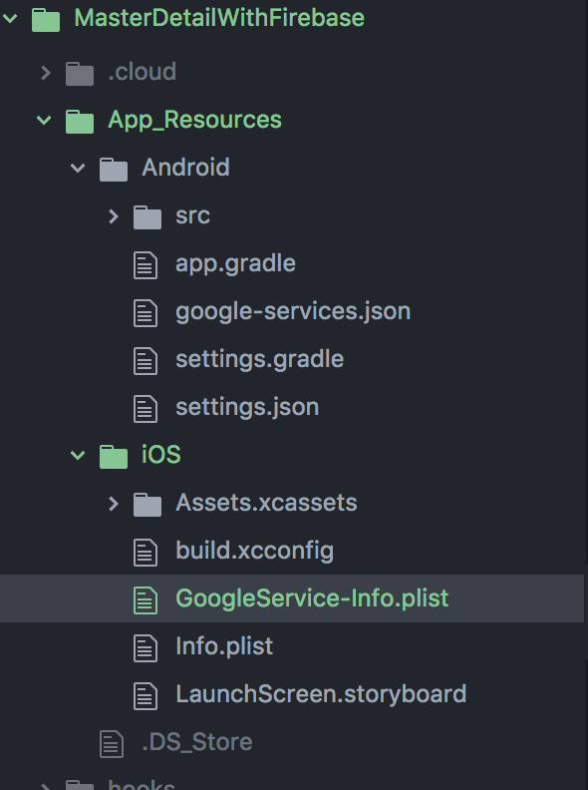
7 Replace the existing configuration files in your NativeScript-App
Notes:
Google-services.json and GoogleService-info.plist

Slide 43
8 Get the Project id from the Firebase-project
In Firebase go to Project settings (the settings button is to the right of the Project Overview side menu item)
Copy the Project ID

Slide 44
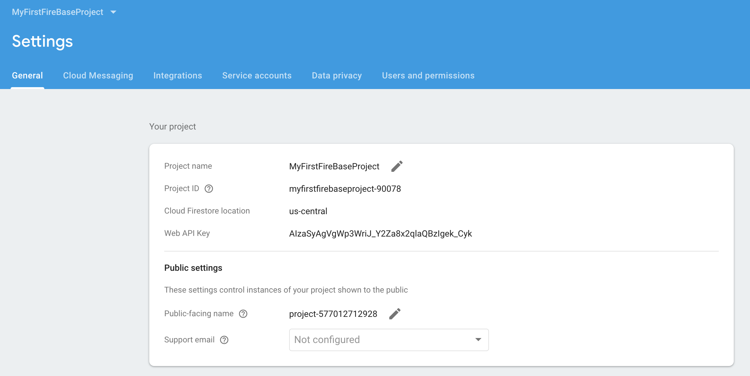
9 Project settings

Slide 45
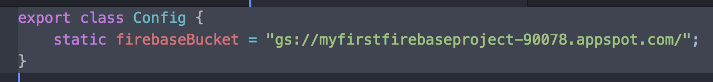
10 Get the Project id from the Firebase-project
Replace the Project ID in src/app/shared/config.ts
For example if your Project ID is myfirstfirebaseproject-90078, the updated config.ts in yout {NS-project} will look like:

Slide 46
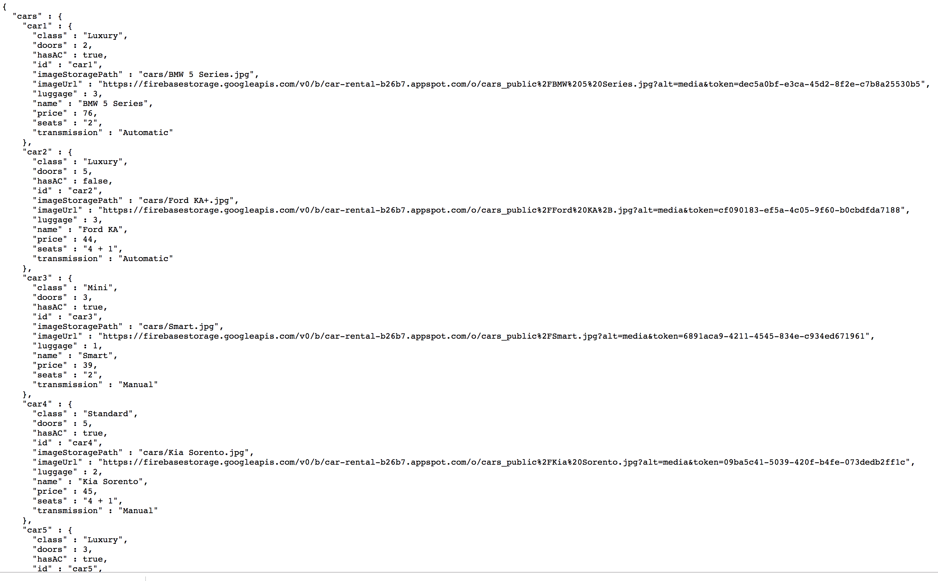
11 Import sample JSON data in Firebase Database
Sample data:
https://github.com/NativeScript/template-master-detail-ng/blob/master/tools/firebase/car-rental-export-public.json

Slide 47
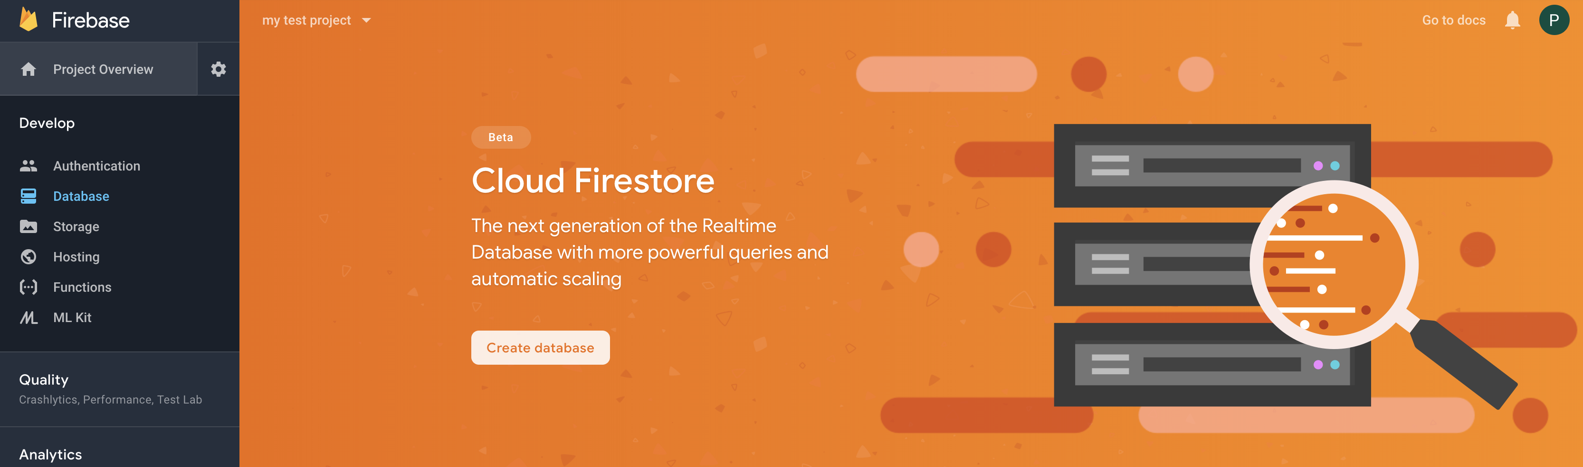
12 Press button: Create Database

Slide 48
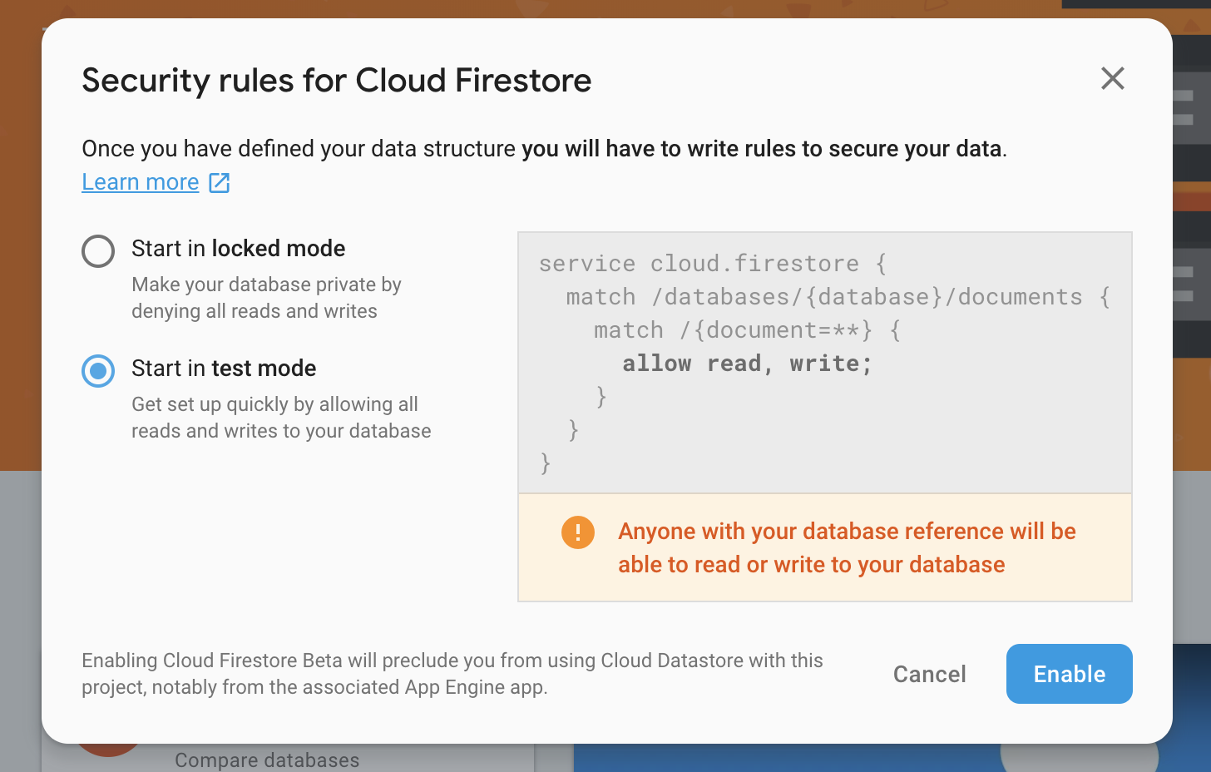
13 Start in test mode

Slide 49
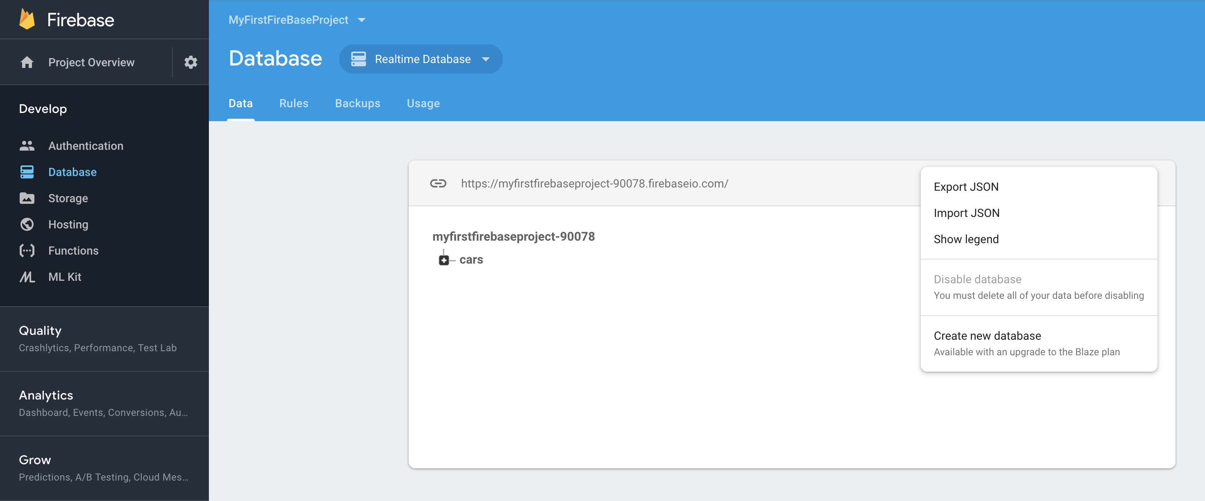
14 Choose Realtime Database

Slide 50
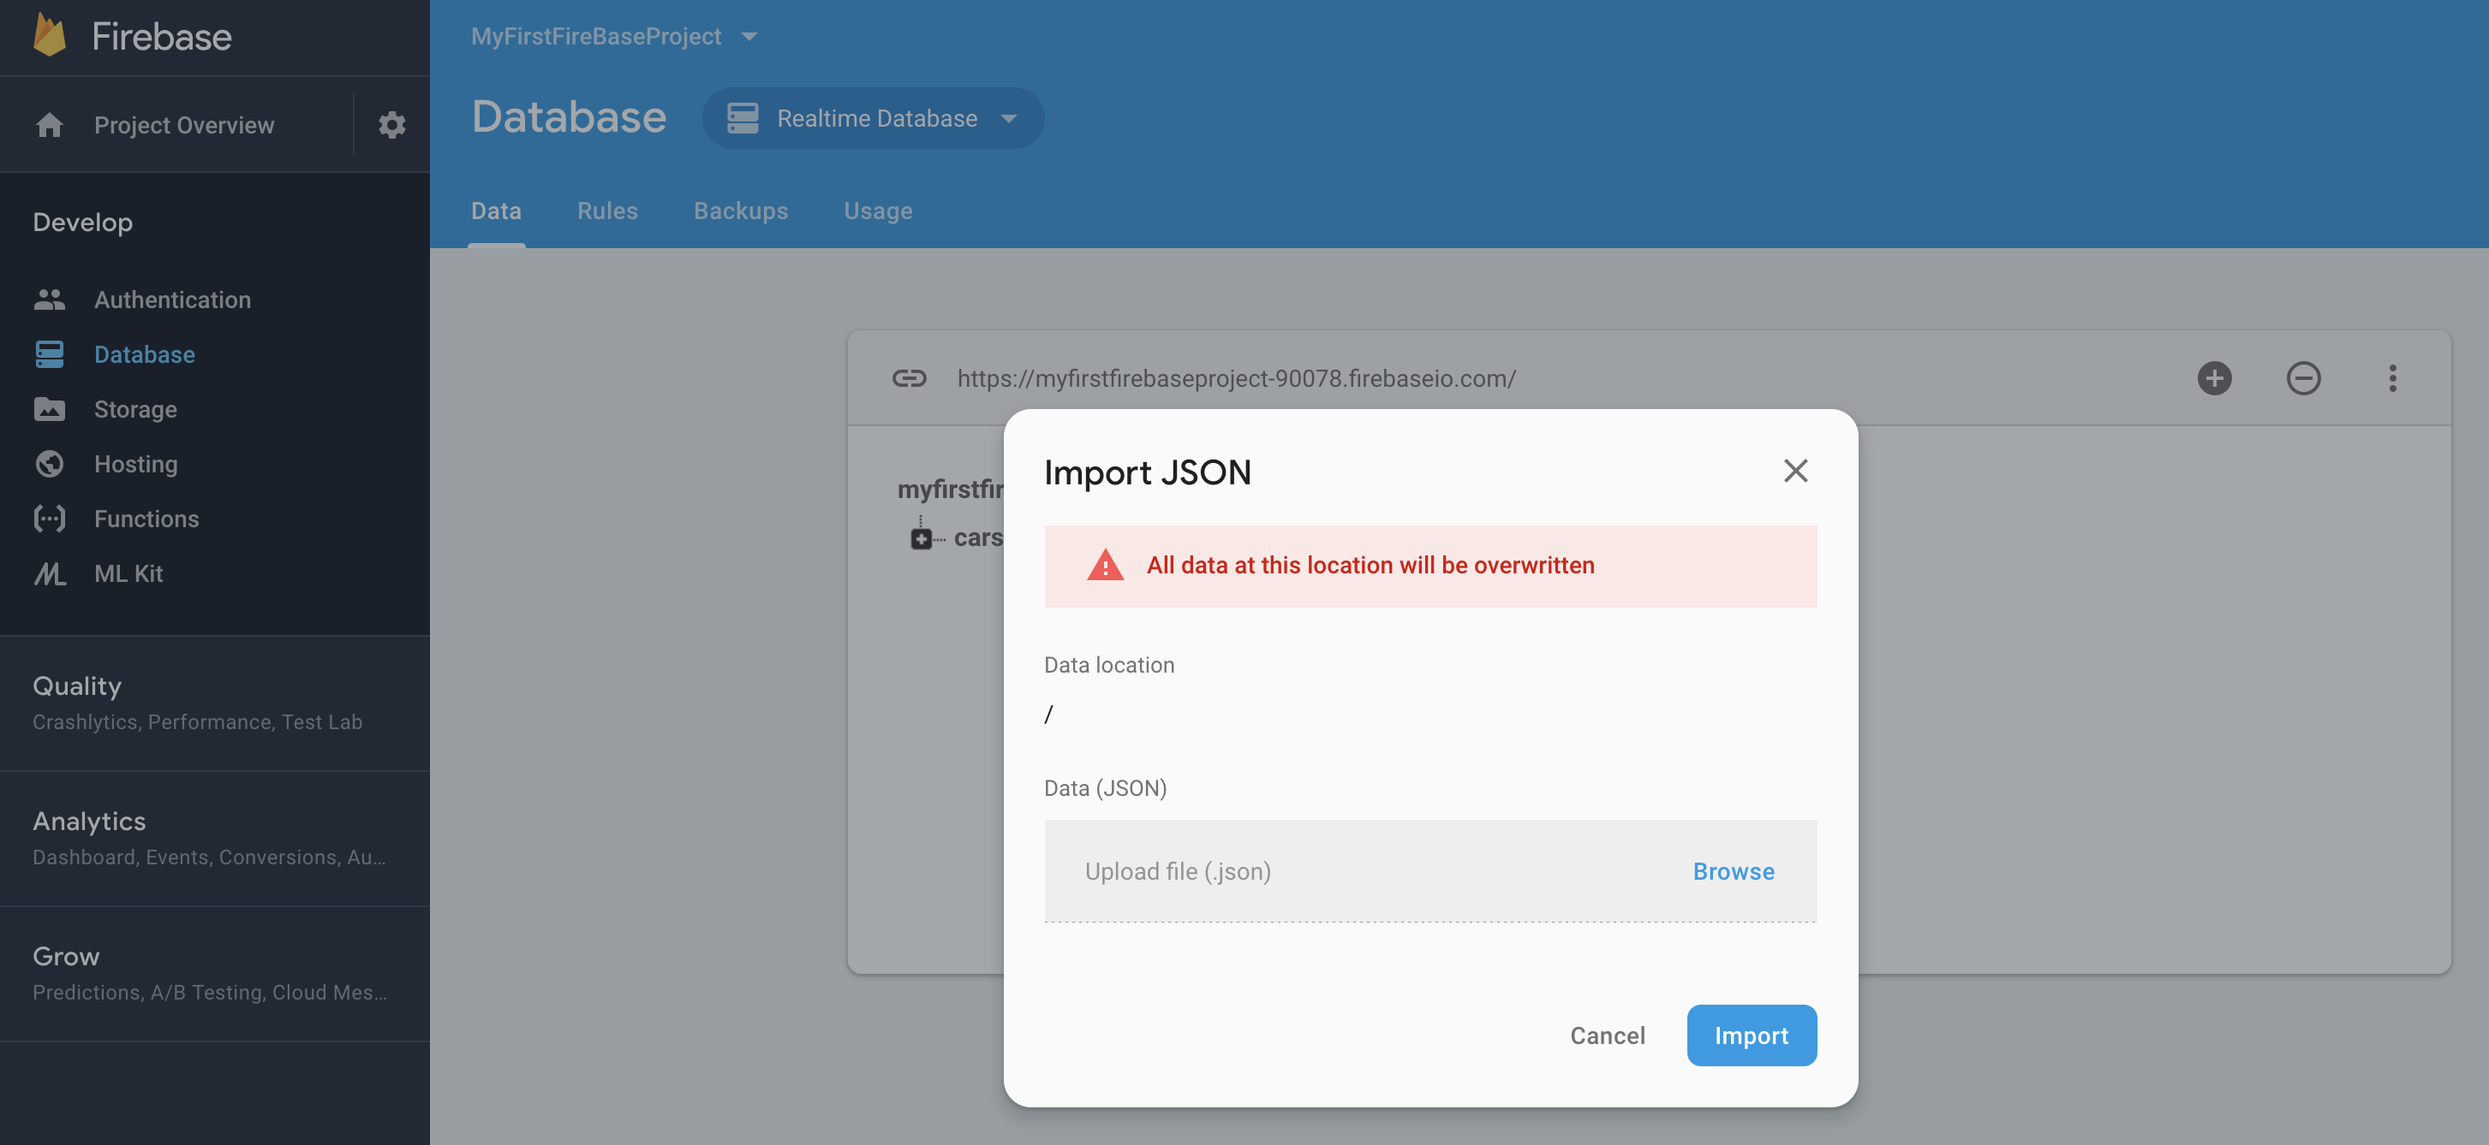
15 Import JSON

Slide 52
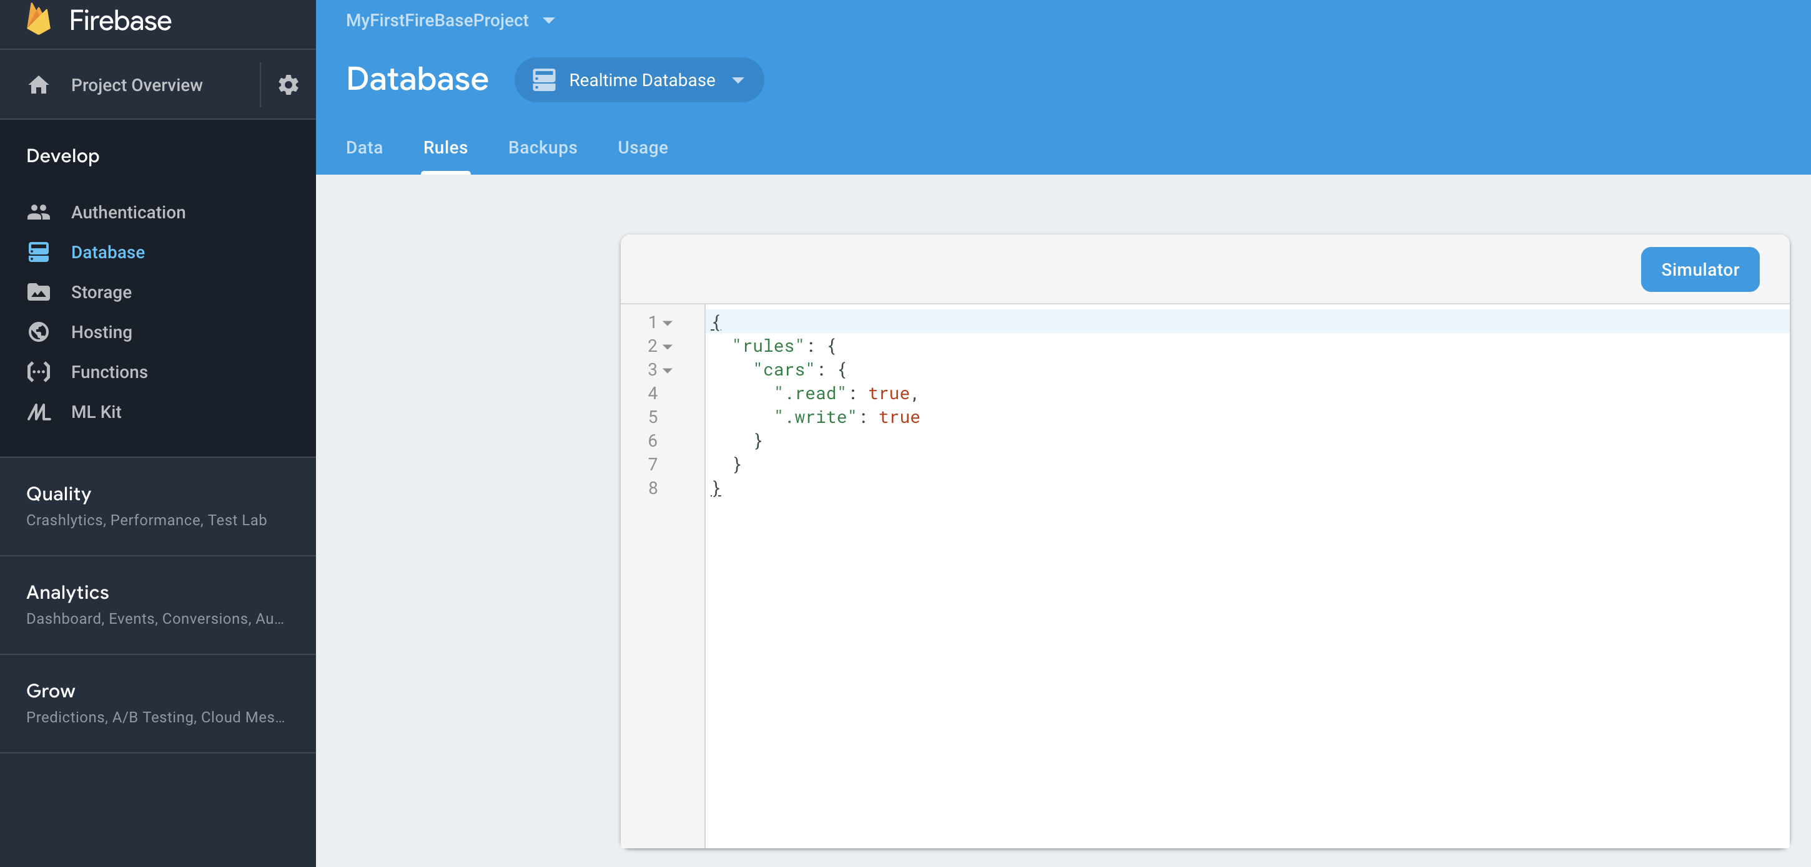
17 Set Default database security rules

Slide 53
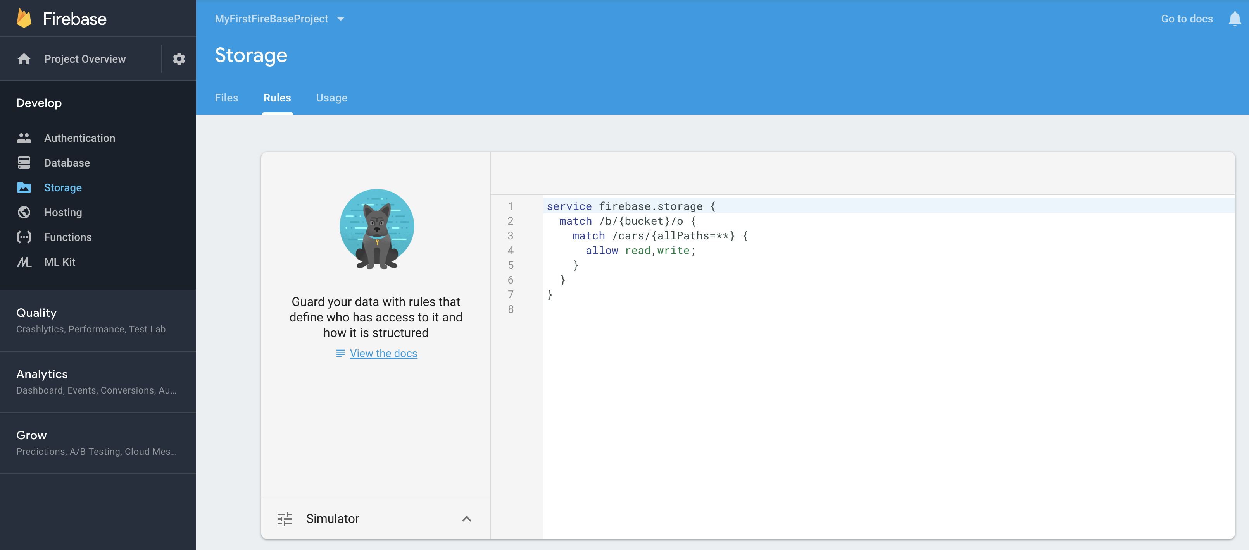
18 Set Default database storage rules

Slide 54
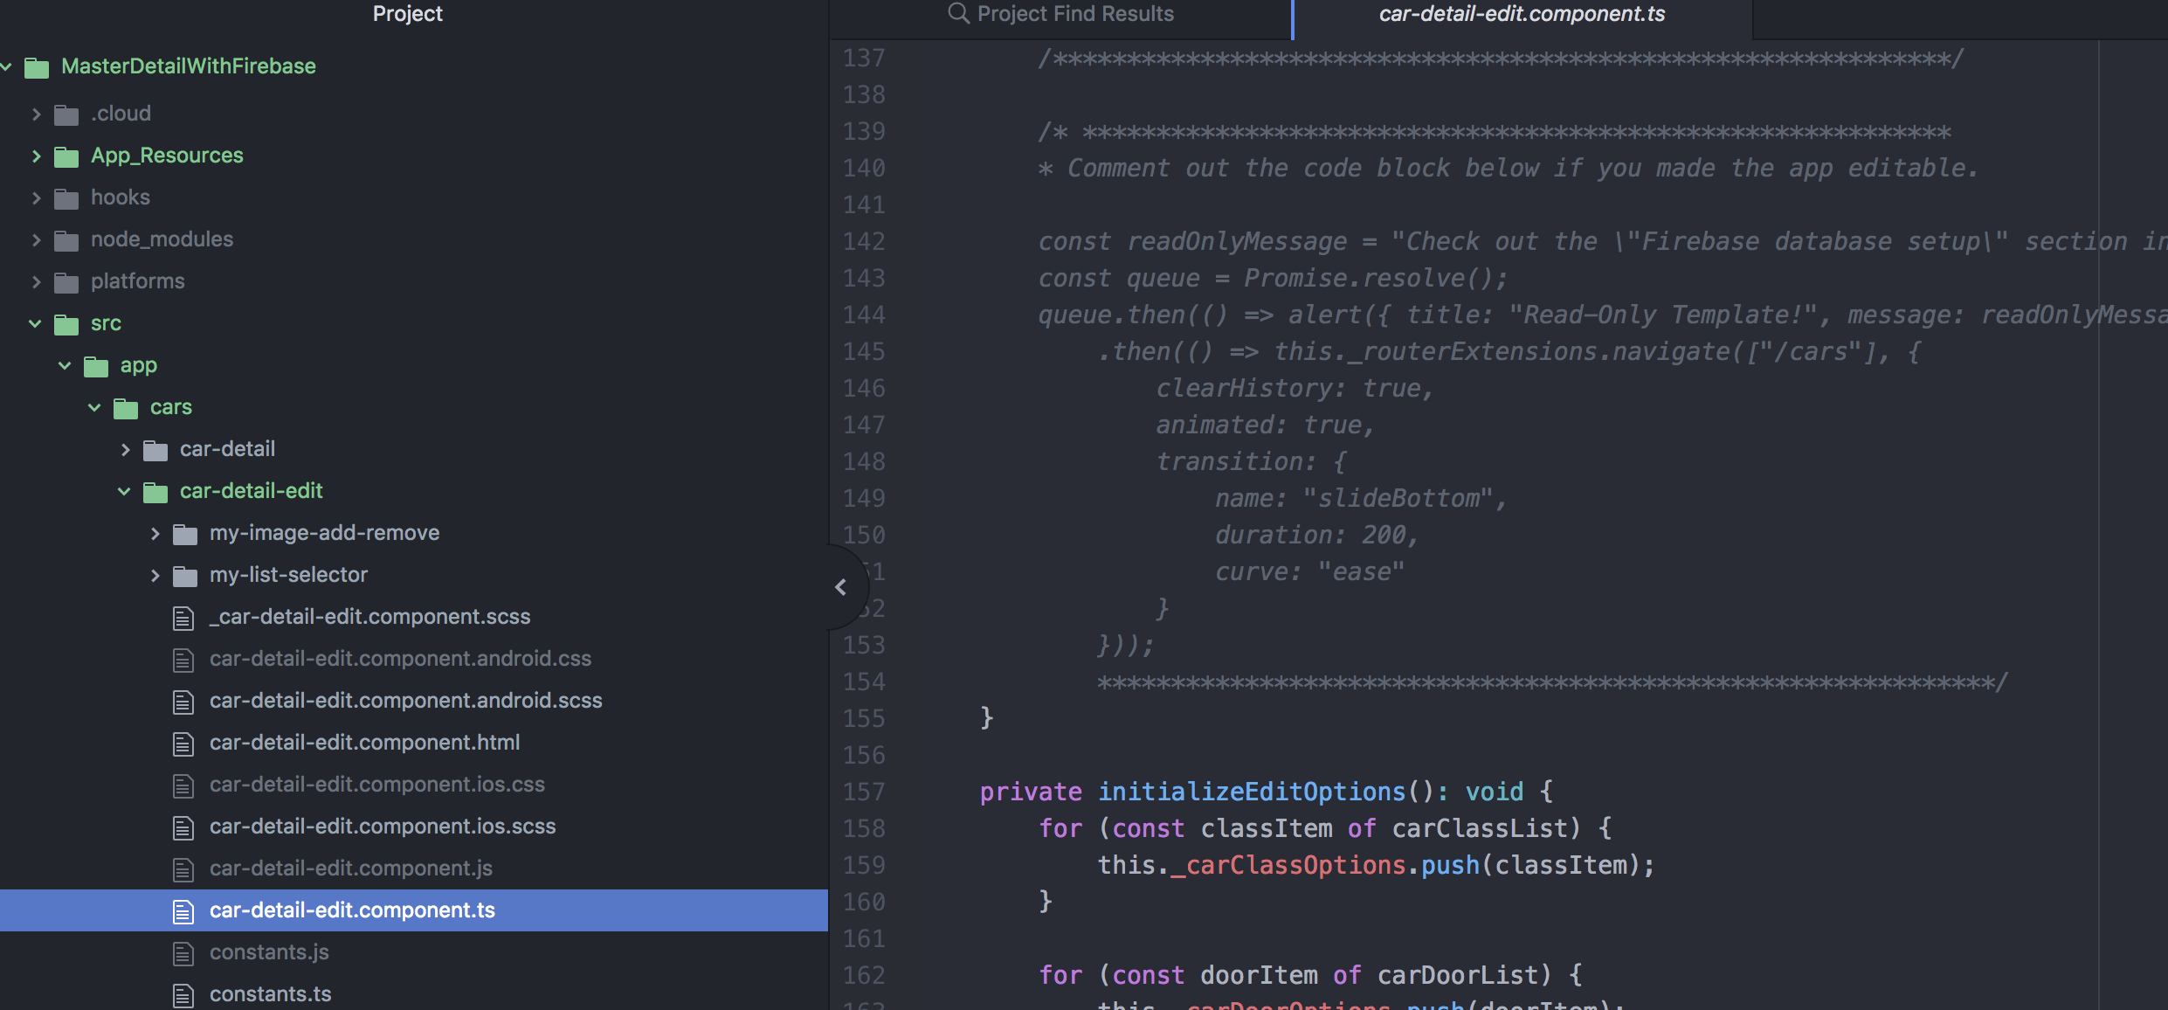
19 Comment out the readonly section in this car detail edit component

Slide 55
Android emulator
tns login
tns run android --emulator
Select "Configure for Local Builds" to run the setup script and automatically configure your environment for local builds.

Slide 56
iOS simulator
tns login
tns run ios –emulator
Select "Configure for Local Builds" to run the setup script and automatically configure your environment for local builds.
[Do not install Android SDK (takes to much time)]

Slide 57
Use your Android Device
Access developer settings on your Android Device
Launch the settings app from your Home screen or the app drawer.
Tap on About Device. It's all the way down at the bottom of the menu.
Tap on Software info.
Tap on Build number 7 times.
Enable Developer options
Enable USB debugging
Install Android File Transfer (https://www.android.com/filetransfer/)
Install Android USB Driver: https://developer.android.com/studio/run/win-usb

